Slide 1

www.studymafia.org
Seminar
On
Quantum Computing
Submitted To: Submitted By:
www.studymafia.org www.studymafia.org

Slide 2
Content
Introduction
History
Why quantum computer
What special about quantum computer
Applications of quantum computer
Problems
Conclusion

Slide 3
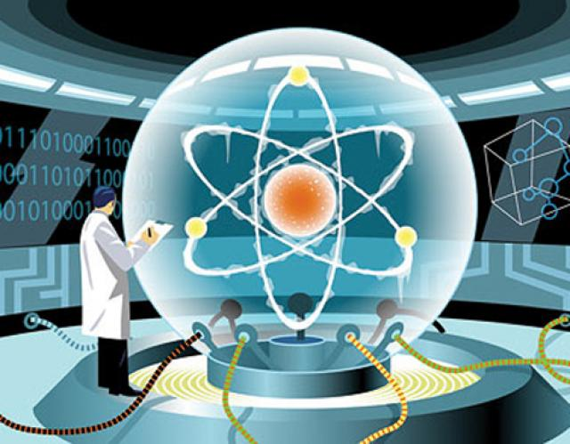
Quantum computers
Quantum computers use atoms to perform calculation
Here computation depends on principle of quantum theory
Qubit

Slide 4
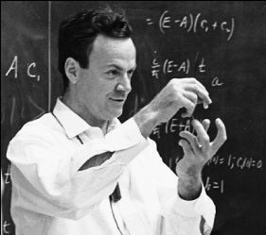
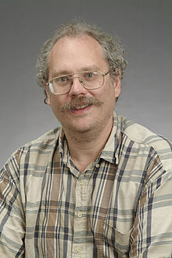
HISTORY
1982 - Feynman proposed the idea of creating machines based on the laws of quantum mechanics instead of the laws of classical physics.
1985 - David Deutsch developed the quantum Turing machine, showing that quantum circuits are universal.
1994 - Peter Shor came up with a quantum algorithm to factor very large numbers in polynomial time.
1997 - Lov Grover develops a quantum search algorithm with O(√N) complexity

Slide 5
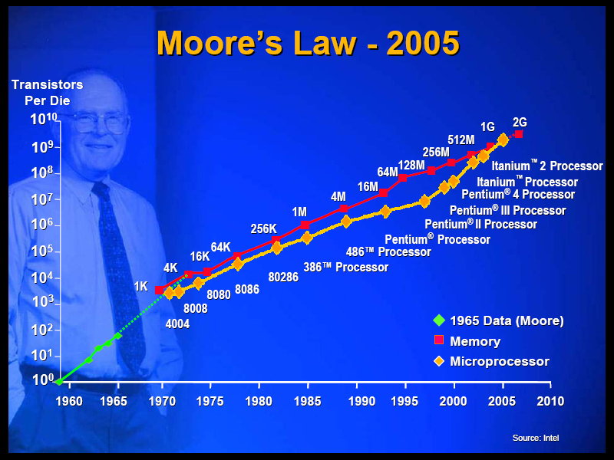
Why quantum computer
Moore’ law slowing down in 2020 it is flattened out.
Transistor cannot be made smaller due to the laws of Quantum mechanics starts to take over
Post silicon era

Slide 6
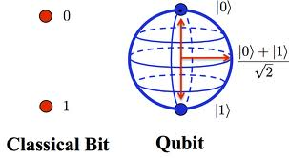
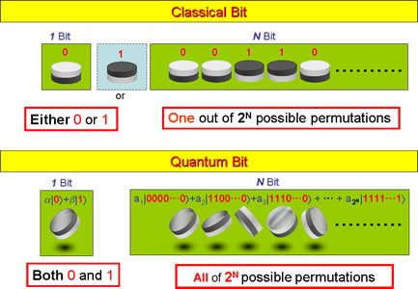
What special about Quantum computer

Slide 7
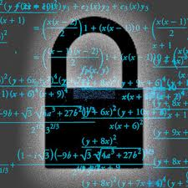
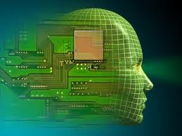
APPLICATIONS
Cryptography
Artificial intelligence
Teleportation
Quantum communication

Slide 8
Problems
Decoherence
Error correction
Output observance
Cost

Slide 9
Conclusion
A quantum computer thus has the theoretical capability of simulating any finite physical system and may even hold the key to creating an artificially intelligent computer.

Slide 10
Reference
www.google.com
www.wikipedia.org
www.studymafia.org

Slide 11
THANK YOU

Slide 12
Queries?

